Slide 1


DEPARTMENT OF COMPUTER SCIENCE & ENGINEERING
Subject Name: Multimedia Technologies
Subject Code: (20CST-334/20ITT-334)
Lecture 12
Topics Covered: Adding sound to your multimedia
project.
DISCOVER . LEARN . EMPOWER

Slide 2
Adding sound to your multimedia project:-
1. Procedure for Windows Users
These instructions are tailored for one specific version of PowerPoint, but there’s not typically that much change between PowerPoint versions so you will still find them useful no matter what version you’re running.
How To Record Audio On PowerPoint
For this tutorial, we’ll assume you don’t have an external audio file to include in your presentation. At the same time, however, you badly want to embellish it and make it a unique, standalone piece.

Slide 3
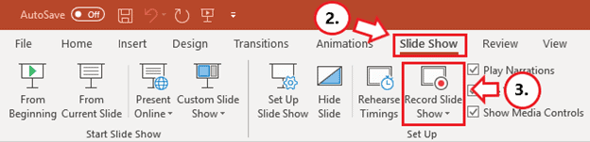
Adding sound to your multimedia project:-
First things first, ensure your microphone is enabled, and the speakers are working. If everything is set, here’s how to record your voice on PowerPoint:
1. For Starters, Design Your Presentation
Prepare your slides in the most creative and informative way you can. One trick is to limit the use of text, focusing on appropriate images to engage your audience better.
2. Select the “Slide Show” Tab
You have to be careful not to add your audio under the Insert option, as it only allows you to save your presentation as a video. The timings won’t be perfectly synchronized to move the slides automatically with the audio.

Slide 4
Adding sound to your multimedia project:-
3. Click On the “Record Slide Show” Option
Older versions of PowerPoint tend to start recording automatically. However, such versions still work, although they tend to have reduced functionality.
4. Select “Record from Beginning”
This isn’t cast in stone. You could still select Record from Current Slide as your needs dictate. It’s also worth noting that you can re-record any PowerPoint slide using either of these options.

Slide 5
Adding sound to your multimedia project:-
5. Click On the “Record” Icon
Naturally, this is the button with a red dot. For newer versions of PowerPoint, for example, the one in Office 2019, a dialog box will pop up, and all you need to do is click Start Recording.
Unless you’ve rehearsed and are a skilled speaker, you might be better off if you read carefully from a prepared script. In the checkboxes, PowerPoint will ask you to select what you want to record before your audio starts. Usually, these are:
Slide and animation timings
Narrations, ink, and laser pointer

Slide 6
Adding sound to your multimedia project:-
6. Record Your Narration
Here’s how to narrate a PowerPoint:
While you record, ensure you are relaxed and avoid reading too loudly or in a monotone. You need to read at a good volume and ideally, you want to sound natural (like you’re having a conversation). You can always click the Replay button if you would like to listen to your progress or confirm whether it was recorded in the first place.
For more recent versions of PowerPoint, there’s the Repeat icon. It’s a backward-pointing arrow very similar to the Undo button you see on your text editor. If you click this, everything starts all over again on the current slide.
7. Move to the Next Slide
Once you finish recording, simply click the STOP button. It’s the middle one with a square. If you’re recording for more than one slide, click the Advance button. It will tell you to advance to the following animation or slide.
For newer versions, simply select the Next button. It’s the short forward-pointing arrow just to the left of the Pause button. Be sure to stop speaking for a second or two to prevent the audio from cutting out in the next slide. You need to do this for all slides.

Slide 7
Adding sound to your multimedia project:-
8. Exit Recording
Press the Escape button (Esc) on your keyboard or simply click the X button on your screen when the recordings are complete. A speaker icon will appear on all slides that have audio.
9. Saving the Presentation
Click File and first save as a regular PowerPoint presentation with the .pptx extension.
10. Exporting the File
Select Export, then proceed to Create a Video. Although it’s optional, you should go for the Full HD (1080P). Next, choose Use Recorded Timings and Narrations and click on the icon labeled Create Video.
Follow the next pop-up window to save your video in your chosen location. You might want to monitor the progress indicator (PowerPoint won’t tell you the average time needed. You won’t receive any notification when it’s finished, either).

Slide 8
Adding sound to your multimedia project:-
Add External Audio
If you’re not up to the task of recording audio directly on PowerPoint, you only need to use a supported audio file type like MP3 or WAV. Here are the detailed steps on how to add audio to PowerPoint:
1. Select a Slide
Open PowerPoint and select a slide. Click Insert.
2. Select “Audio”
Just click on that speaker icon and from the tiny dropdown menu, select Audio on My PC

Slide 9
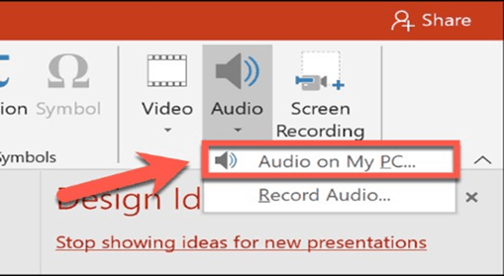
Adding sound to your multimedia project:-

Slide 10
Adding sound to your multimedia project:-
3. Locate the Audio File and Finish
Locate the audio file you want to insert from your PC and click the Insert button again.
The inserted audio appears as a speaker icon. When you select it, you will see playback options. During the presentation, simply hover over the icon to reveal playback options.

Slide 11
Reference and text books:-
TEXT BOOKS
Tay Vaughan, “Multimedia making it work”, Tata McGraw-Hill, 2008.
Rajneesh Aggarwal & B. B Tiwari, “Multimedia Systems”, Excel Publication, New Delhi, 2007.
Li & Drew, “Fundamentals of Multimedia”, Pearson Education, 2009.
REFERENCE BOOKS
Parekh Ranjan, “Principles of Multimedia”, Tata McGraw-Hill, 2007
Anirban Mukhopadhyay and Arup Chattopadhyay, “Introduction to Computer Graphics and Multimedia”, Second Edition, Vikas Publishing House.

Slide 12
Any query ??

Slide 13
Thank you

